Slide 1
Applying Reinforcement Learning to Maximise PV Self-Consumption for Electric Vehicle Charging
Author: Eric Massip Cano
Promotor: Prof. dr. ir. Geert Deconinck
Assesor: Dr. ing. Ján Drgona
Supervisors: Dipl. ing. Brida Verwiyni Mbuwir & Dr. ing. Klaas Thoelen

Slide 2
Index
Introduction
Data Analysis
Demand Response Algorithm
Experiment setup
Results
Conclusion
ESAT

Slide 3
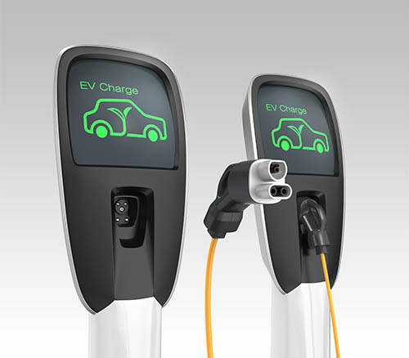


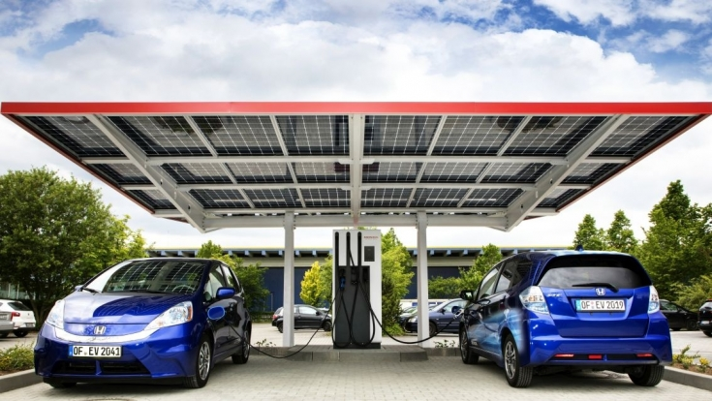
Introduction: EV Charging
No green-house gas emissions
High electricity demand
Solution RES Self-Consumption
ESAT

Slide 4

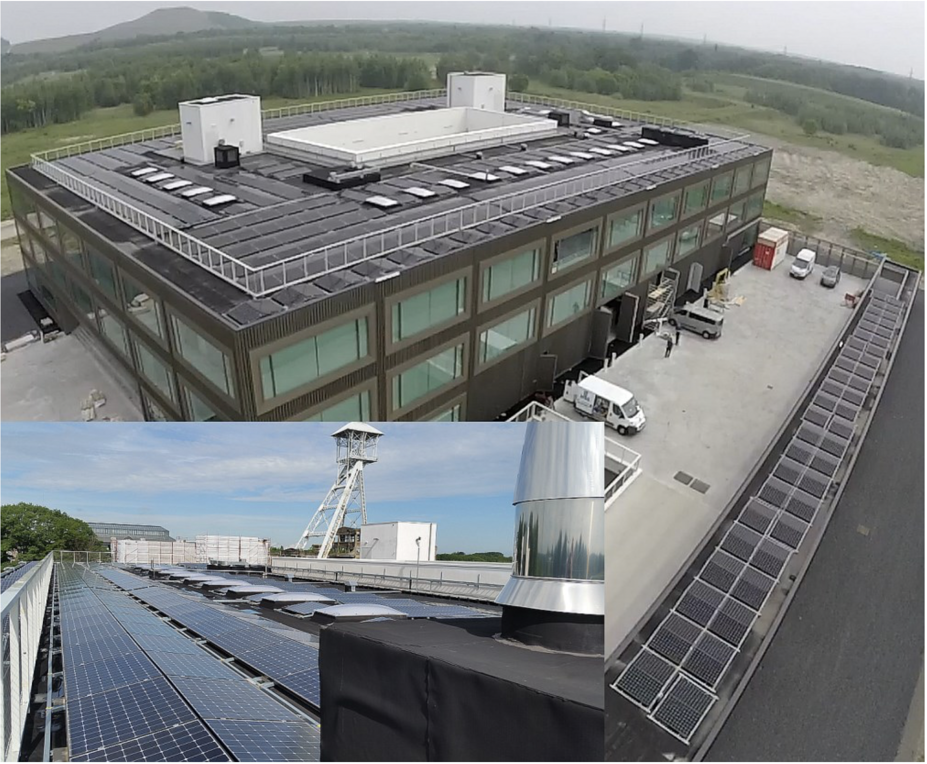
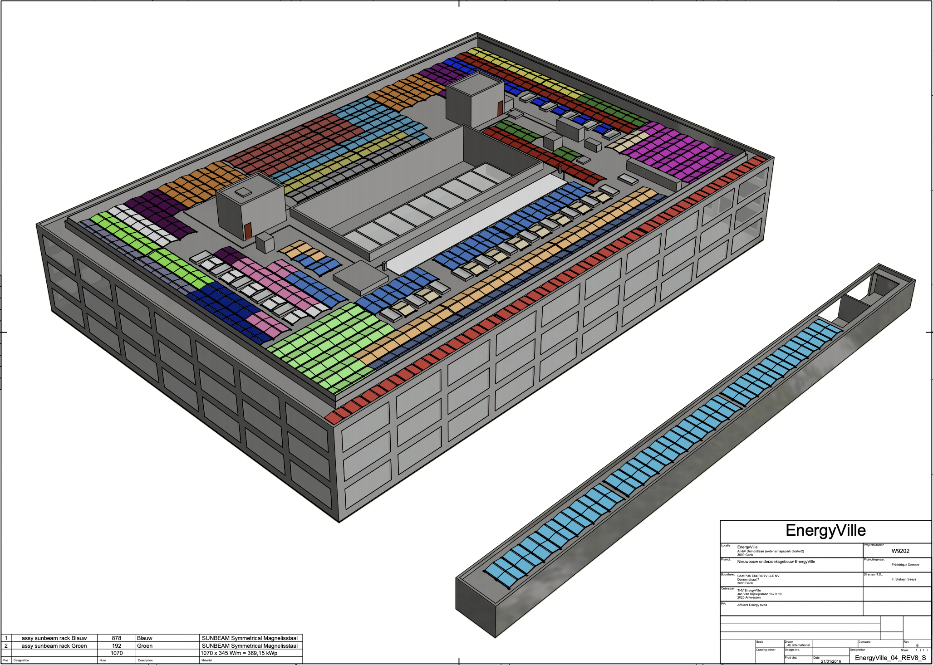
Introduction: PV Installation at
4 orientations facing North, South, East and West
24 three-phase inverters
Maximum generation capacity 450 kW
$$≃$$
G. H. Yordanov, F. Smolders, A. Olaerts, G. Verbeek, K. Baert, and J. Driesen. A 368-kWp Grid-connected PV System : Known and Hidden Losses. EU PVSEC Programme Planner, pages 1909–1914, 2017.
ESAT

Slide 5
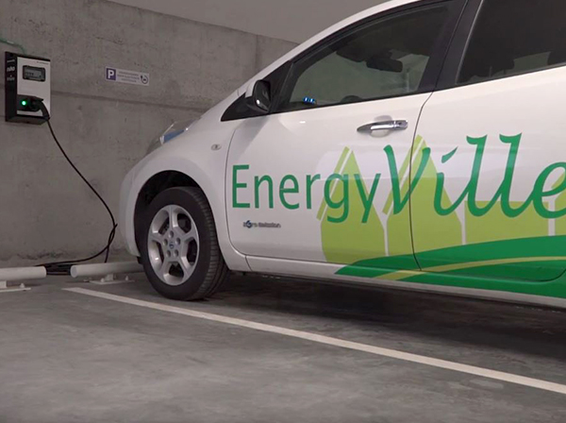
Introduction: EV Charging Infrastructure at
Charging Station | Connectors | Charging Rate | Quantity
Simple | 1 |  | 6
Smart | 2 |  | 6
Supercharger | 1 |  | 1
$$≤3kWh$$
$$≃$$
$$≤22kWh$$
$$≥22kWh$$
ESAT

Slide 6
Introduction: Smart Charging
Demand Response Algorithms: Control algorithms that, given information about the environment, either delay or proceed with the charging in order to optimize the charging for a given goal.
ESAT

Slide 7
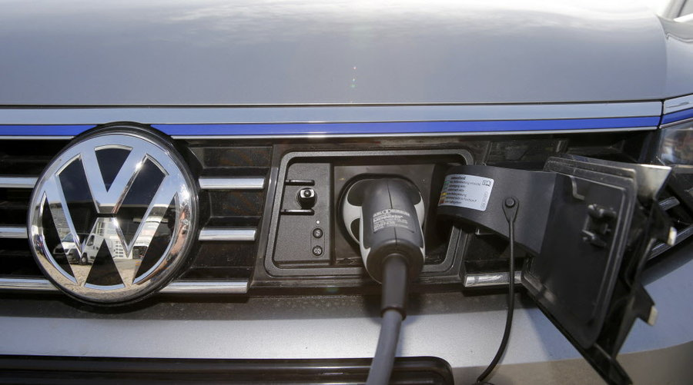


Introduction: Our Goal
Balance the aggregate load of charging EVs against the PV energy generated by the PV installation, by means of a DR algorithm using Reinforcement Learning.
ESAT

Slide 8
Index
Introduction
Data Analysis
Demand Response Algorithm
Experiment setup
Results
Conclusion
ESAT

Slide 9
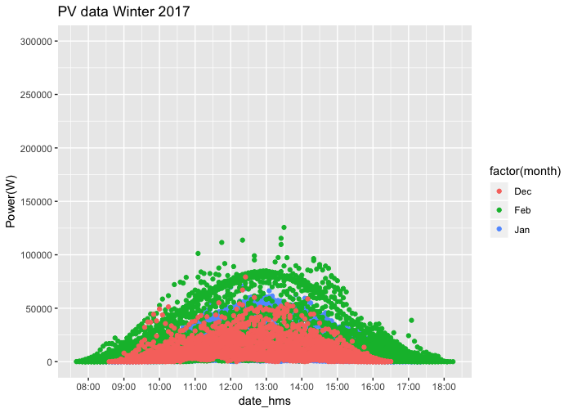
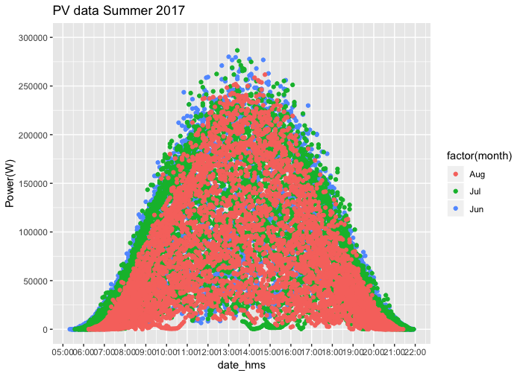
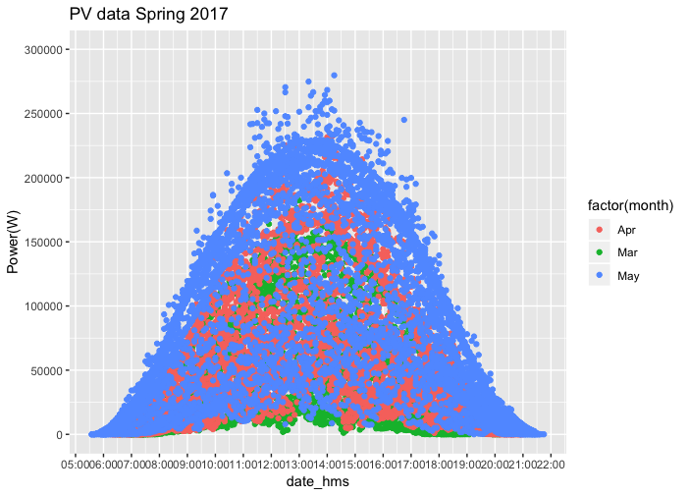
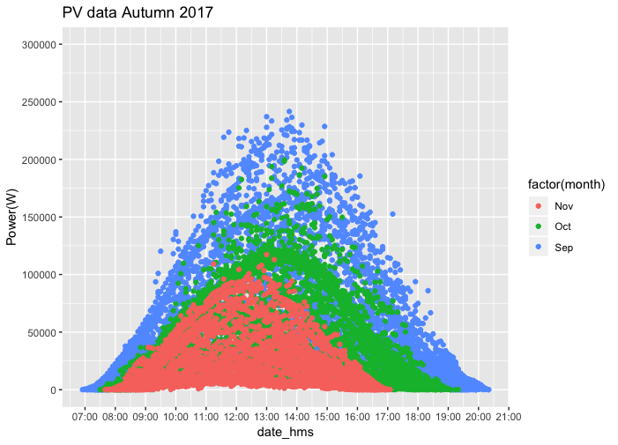
Data Analysis: PV Dataset
Average charging rate = 7.5 kWh
Nº of charging connectors available = 8
Maximum power demand in an hour = 60 kW
Scaling factor = 20 %
ESAT

Slide 10
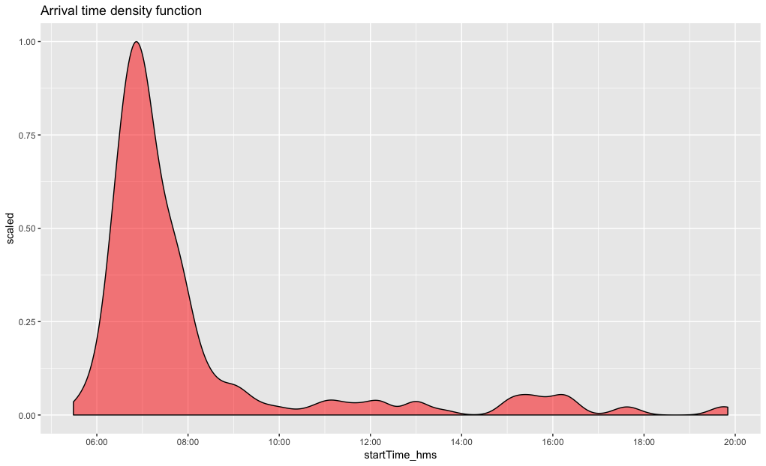
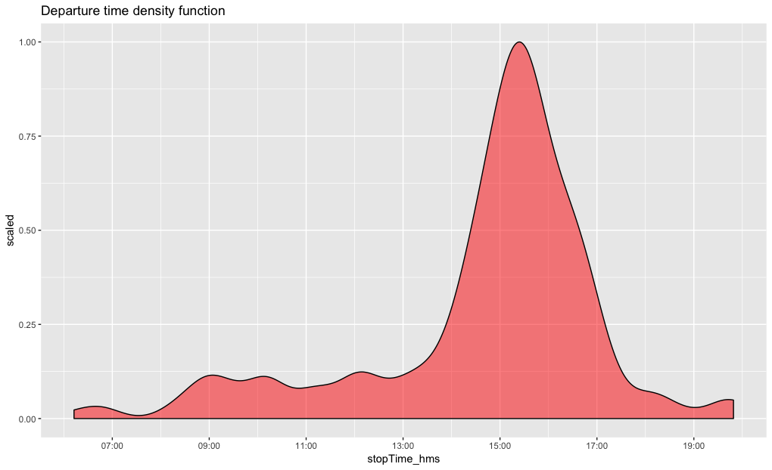
Data Analysis: Charging Transactions Dataset
EV Charging Behaviour
Arrival times distribution:
Mean = 08:05h
IQR = [06:41h, 07:52h]
Departure times distribution:
Mean = 14:41h
IQR = [14:15h, 16:00h]
ESAT

Slide 11
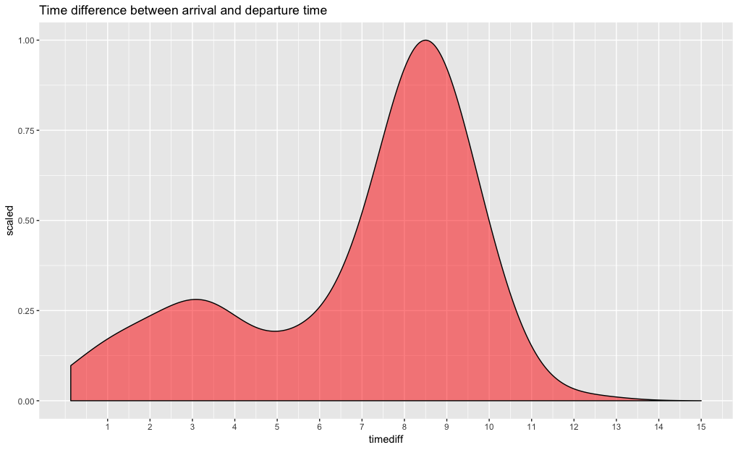
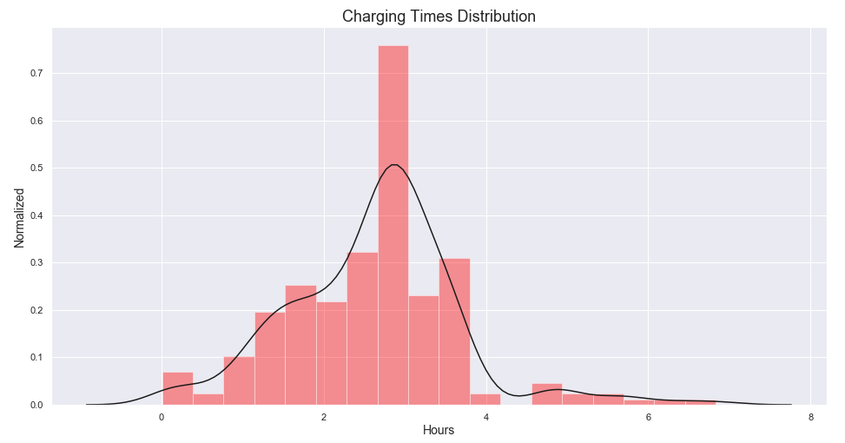
Data Analysis: Charging Transactions Dataset
EV Charging Behaviour
Sojourn times distribution:
Mean = 8.3 hours
IQR = [5.3-8.9] hours
Charging times distribution:
Mean = 2.62h
IQR = [1.9, 3.1] hours
ESAT

Slide 12
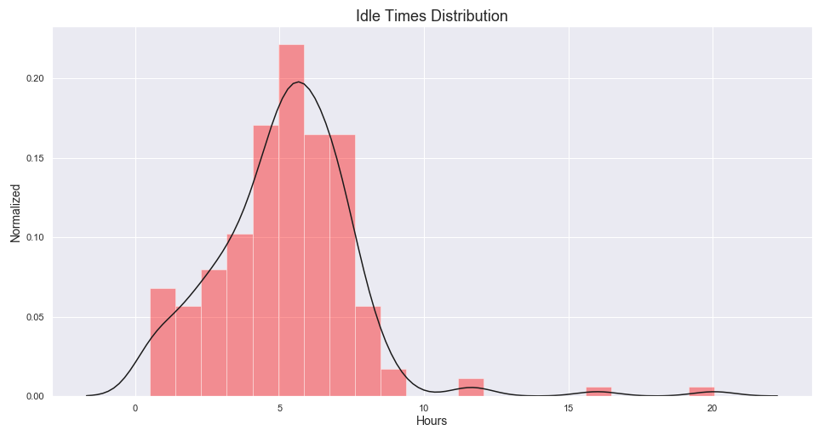
Data Analysis: Charging Transactions Dataset
EV Charging Behaviour
Idle times distribution:
Mean = 5.2 hours
IQR = [3.8, 6.5] hours
ESAT

Slide 13
Index
Introduction
Data Analysis
Demand Response Algorithm
Experiment setup
Results
Conclusion
ESAT

Slide 14
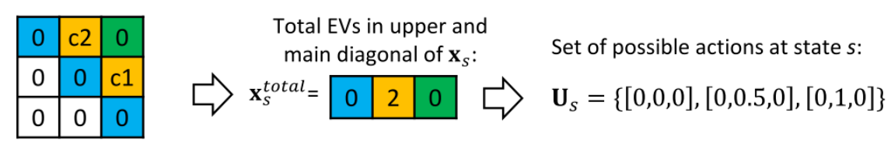
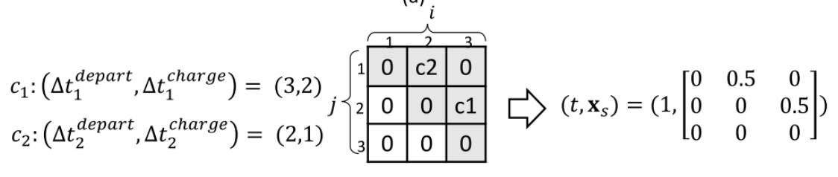
Demand Response Algorithm: Markov Decision Process
State space
Action space
$$s=(t,L_{pv},x_{s})$$
= Set of possible actions at state s
$$U_{s}$$
where
= timeslot
= forecast PV generated at timeslot
= aggregate state space
$$t$$
$$L_{pv}$$
$$t$$
$$x_{s}$$
$$S_{max}×S_{max}$$
N. Sadeghianpourhamami, J. Deleu, and C. Develder. Definition and evaluation of model-free coordination of electrical vehicle charging with reinforcement learning. sep 2018
ESAT

Slide 15
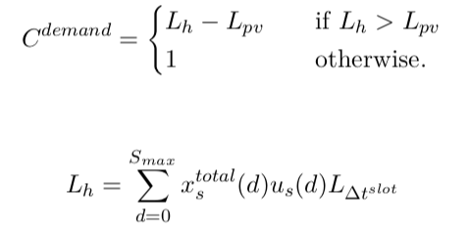
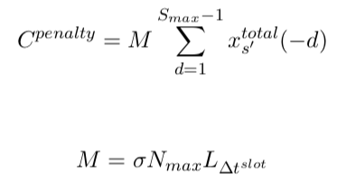
Demand Response Algorithm: Markov Decision Process
Cost Function
Cost Demand
Cost Penalty
+
Cost Demand = Load balancing between production and consumption
Cost Penalty = Penalty for cars that leave before being fully charged
ESAT

Slide 16
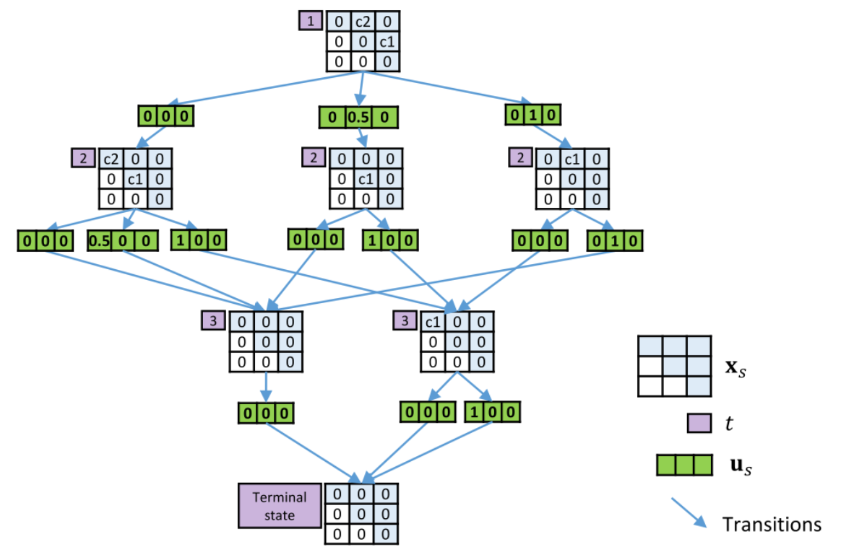
Demand Response Algorithm: Sampling Trajectories
N. Sadeghianpourhamami, J. Deleu, and C. Develder. Definition and evaluation of model-free coordination of electrical vehicle charging with reinforcement learning. sep 2018
ESAT

Slide 17
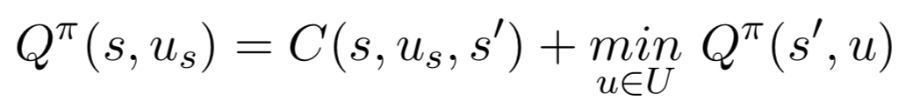
Demand Response Algorithm: Action-Value Function
In RL, an agent takes actions to move from state s to s’ based on a learned policy.
Every state-action pair has an associated cost = Q-value
The goal is to find the optimal policy in order to minimize the expected accumulated cost.
The Q-values of the learned policy are iteratively updated using the Bellman equation:
ESAT

Slide 18
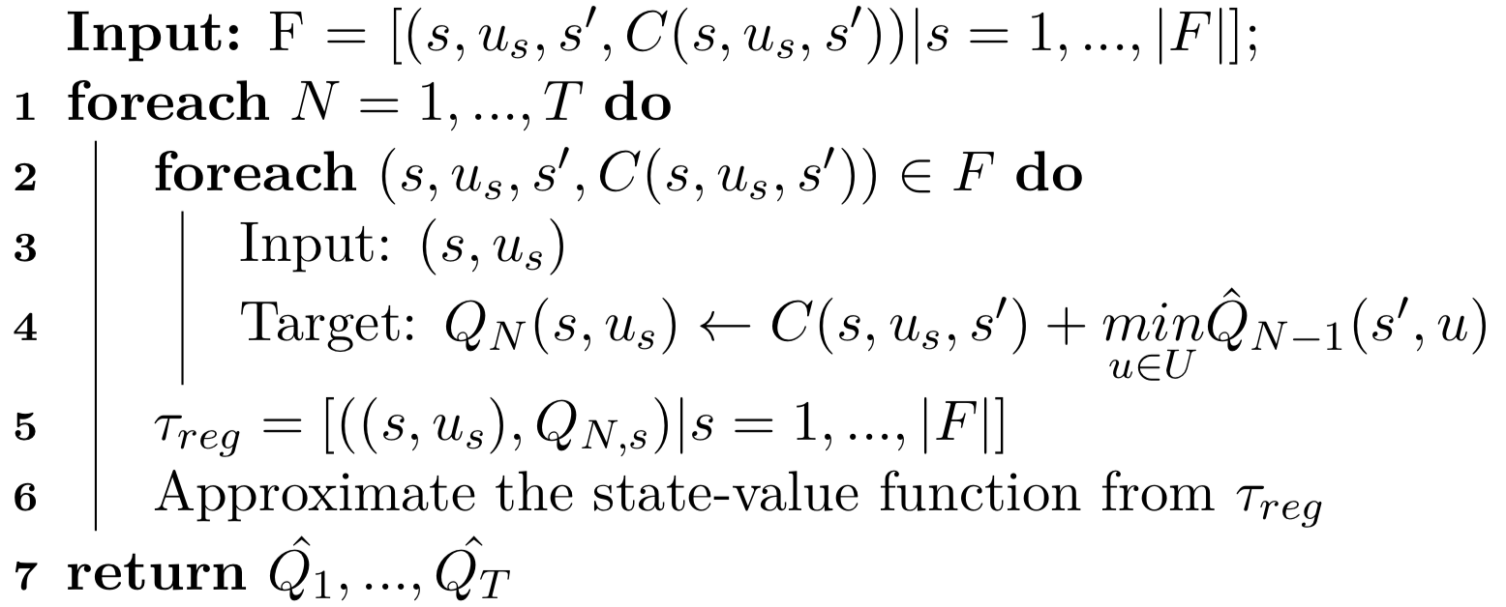
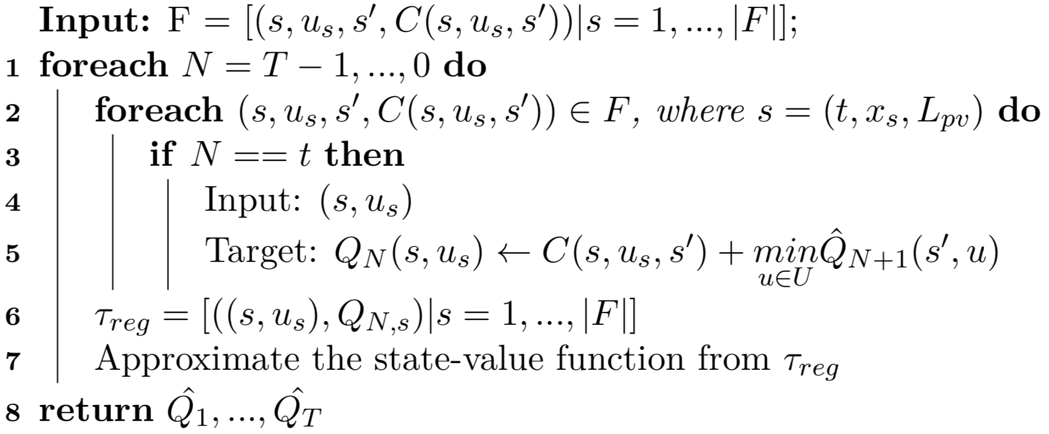
Demand Response Algorithm: Batch RL Algorithms
However, the amount of possible state-action pairs is too large.
The action-value function needs to be approximated using a batch RL algorithm.
Fitted Q-Iteration
Fitted Q-Iteration Reverse
ESAT

Slide 19
Index
Introduction
Data Analysis
Demand Response Algorithm
Experiment setup
Results
Conclusion
ESAT

Slide 20
Experiment Setup: Data Preparation
Charging Transactions dataset
PV dataset
Transactions from Aug 8th to May 3rd 2019
Training set = 76 days
Test set = 19 days
Episodic days from 6am to 10pm (16 hours)
Duration of a time slot = 2 hours
= 8 timeslots
PV power generated every 15min during the 97 days of the dataset
From 00:00h to 23:45h
$$S_{max}$$
ESAT

Slide 21
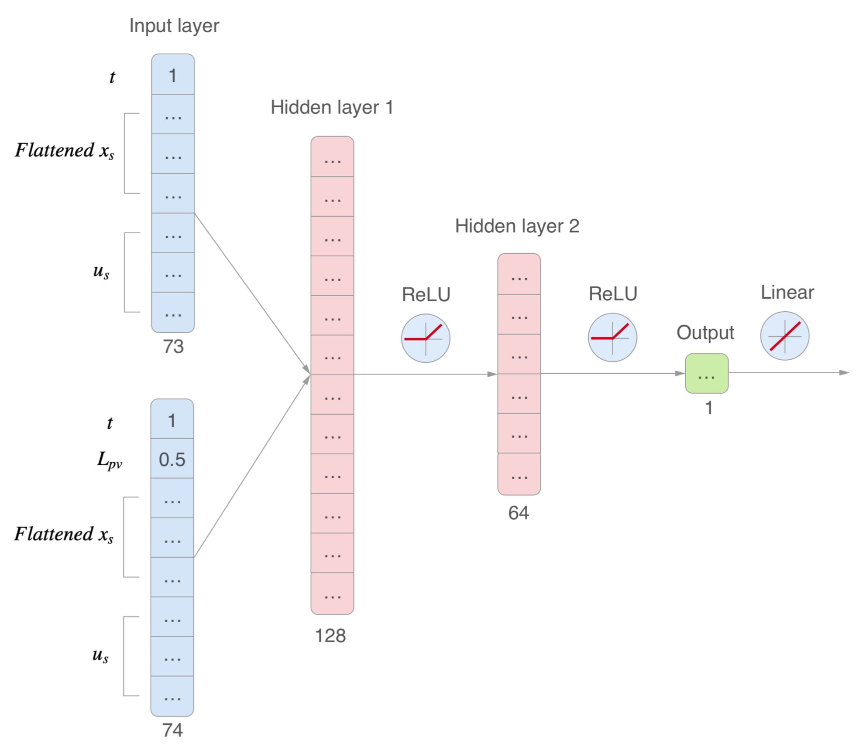
Experiment Setup: Function Approximator
Baseline network
PV network
ESAT

Slide 22
Index
Introduction
Data Analysis
Demand Response Algorithm
Experiment setup
Results
Conclusion
ESAT

Slide 23
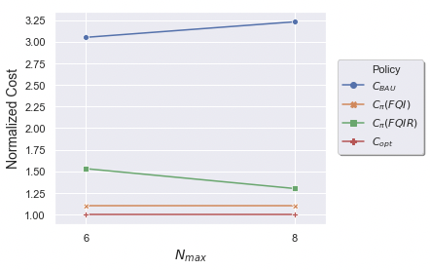
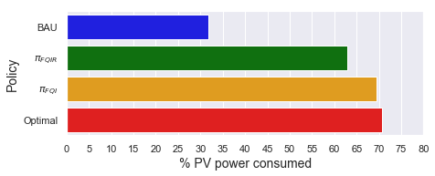
Results: BAU vs FQI vs FQIR
Normalized cost relative to the optimum policy
Percentage of PV energy consumed
ESAT

Slide 24
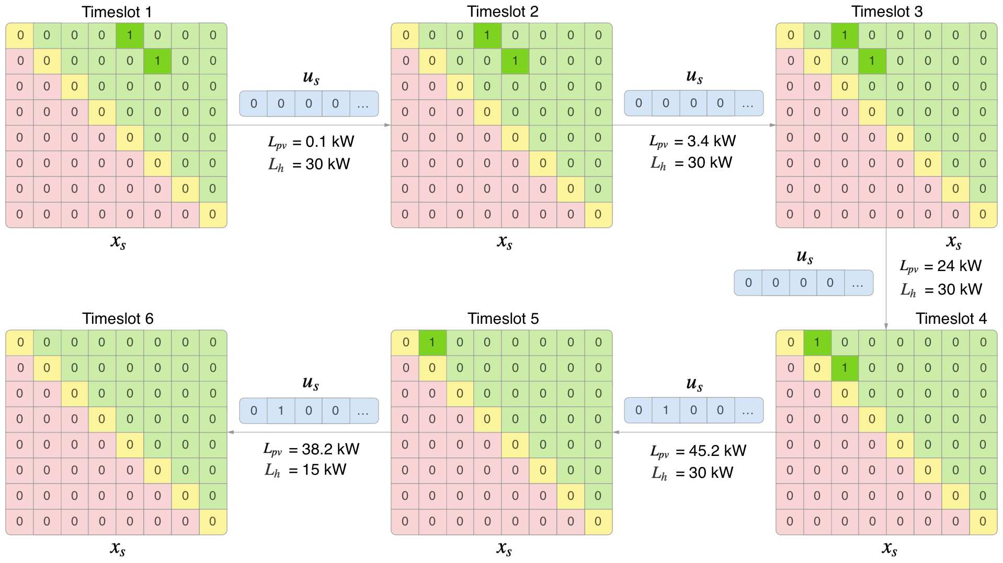
Results: Morning Charging FQIR
ESAT

Slide 25
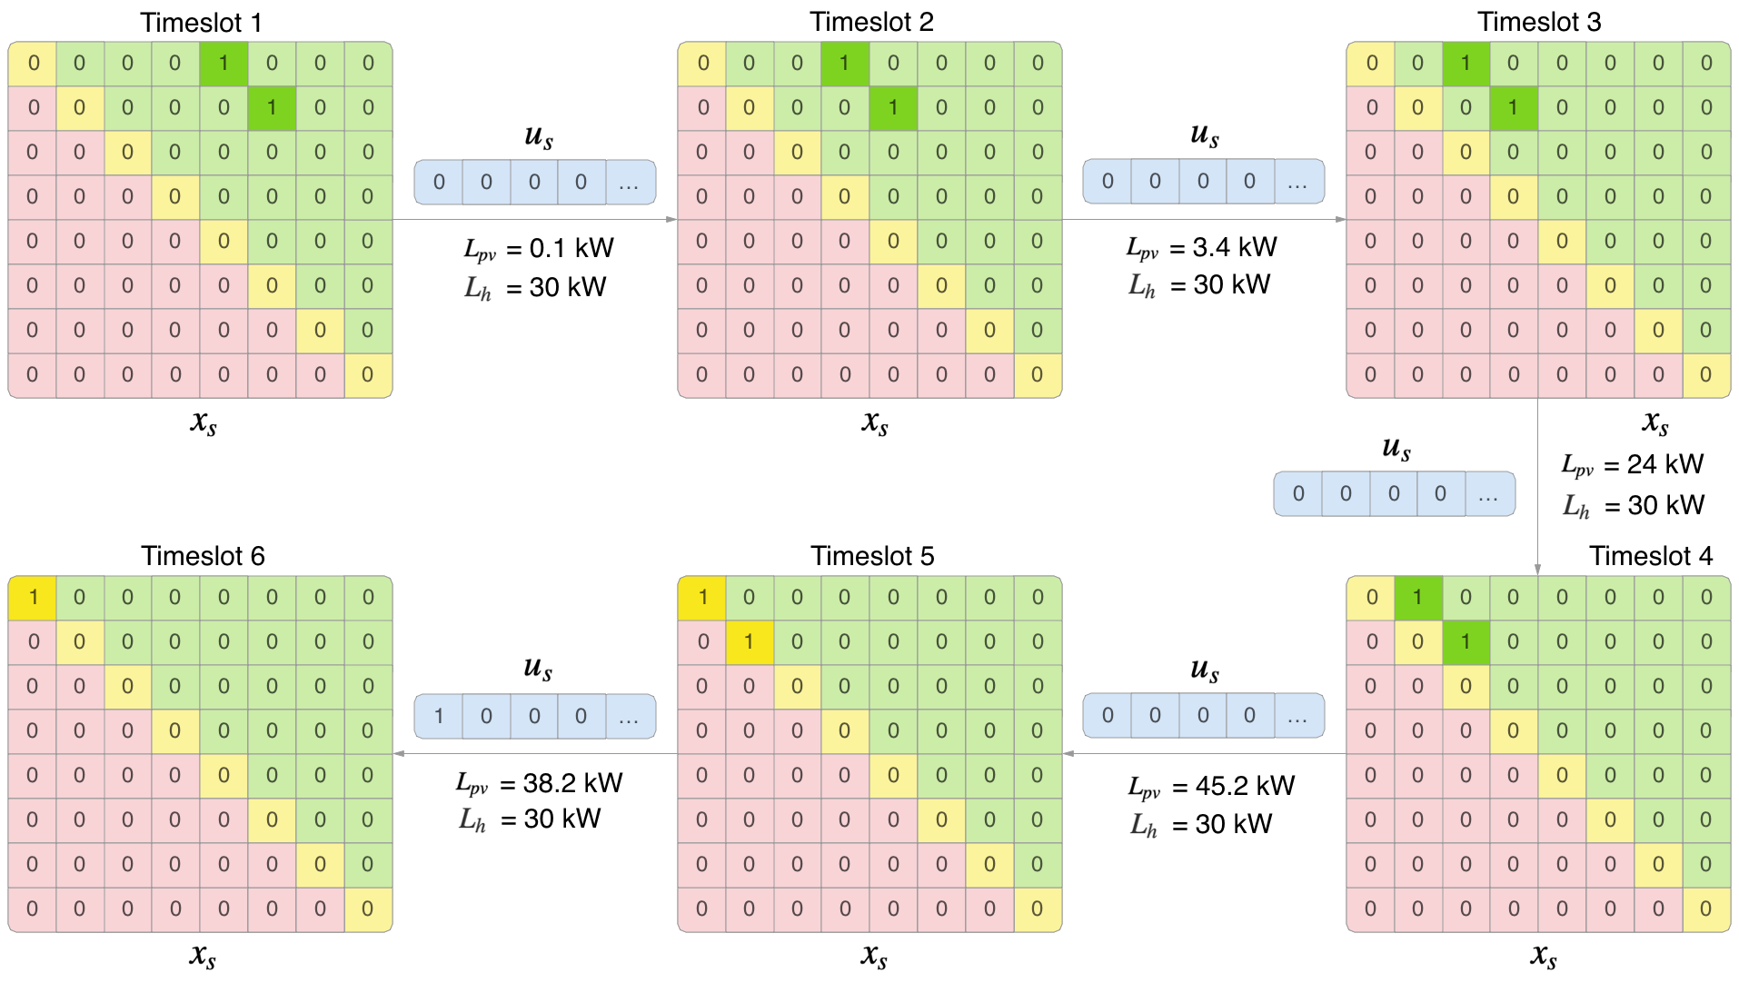
Results: Morning Charging FQI
ESAT

Slide 26
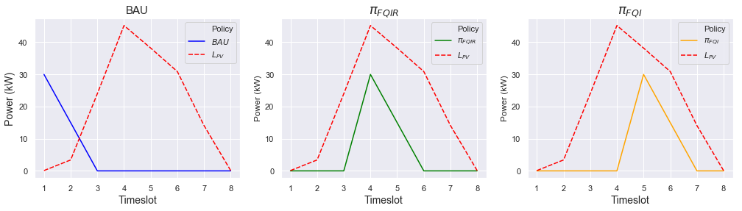
Results: Morning Charging
Behaviour: Two cars connected early in the morning
% PV consumed = 10 %
% PV consumed = 100 %
% PV consumed = 100 %
ESAT

Slide 27
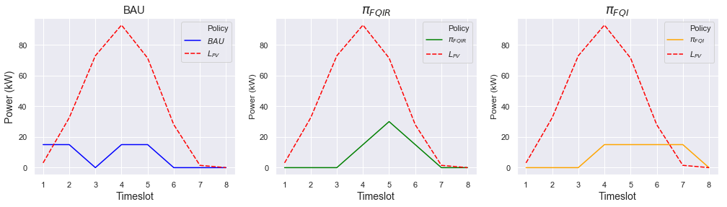
Results: Late Charging
Behaviour: One car connected early in the morning with a late departure, and another one connected in the afternoon
% PV consumed = 80 %
% PV consumed = 100 %
% PV consumed = 80 %
ESAT

Slide 28
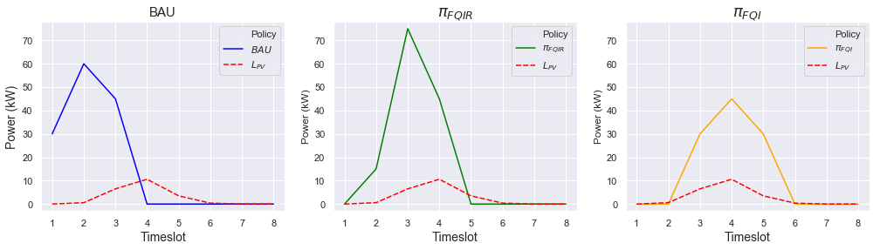
Results: Cloudy Day
Behaviour: Two cars connected early in the morning, and three more connected during the rest of the morning
% PV consumed = 10 %
% PV consumed = 10 %
% PV consumed = 20 %
ESAT

Slide 29
Index
Introduction
Data Analysis
Demand Response Algorithm
Experiment setup
Results
Conclusion
ESAT

Slide 30
Conclusion
69.4 % of the total energy consumed following the best policy learned via the proposed approach is PV self-consumed, improving by 37.6 % over the BAU and below the optimal policy by just 1.2 %.
The strategy of the FQI algorithm is very simplistic but effective if there are no cars with late departures.
The FQIR algorithm doesn’t wait, tries to charge when there is enough forecast PV energy.
The proposed approach is proved to be scalable.
ESAT

Slide 31
Future Work
Test the performance of the proposed approach on a more complex dataset with more stochasticity and more charging stations
Investigate the effect of lower time steps
Introduce a new term in the cost function to encourage the charging to happen as soon as there is enough PV energy generated available for charging
Re-design the state space adding a 3rd dimension to include information about the charging rate for every connected car. Experiment with Convolutional Neural Networks.
Change or combine the objective function for other applications (load flattening, electricity price reduction)
ESAT

Slide 32
Thank you!
ESAT

Slide 33
Appendix
ESAT

Slide 34
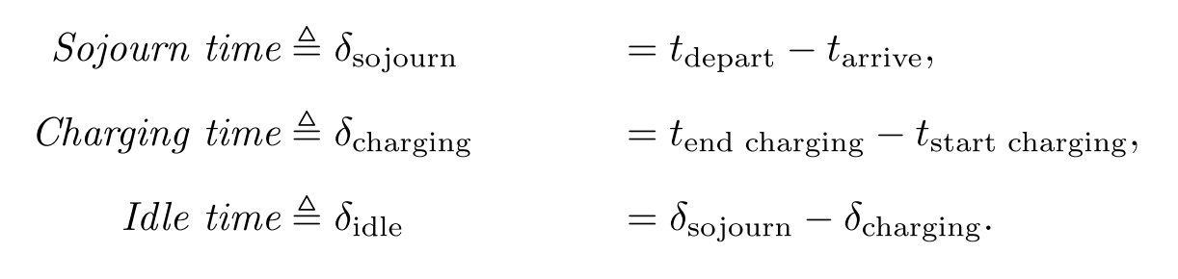
Data Analysis: Charging Transactions Preprocessing
C. Develder, N. Sadeghianpourhamami, M. Strobbe, and N. Refa. Quantifying flexibility in EV charging as DR potential: Analysis of two real-world data sets. In 2016 (SmartGridComm), pages 600–605. IEEE, nov 2016.
ESAT

Slide 35
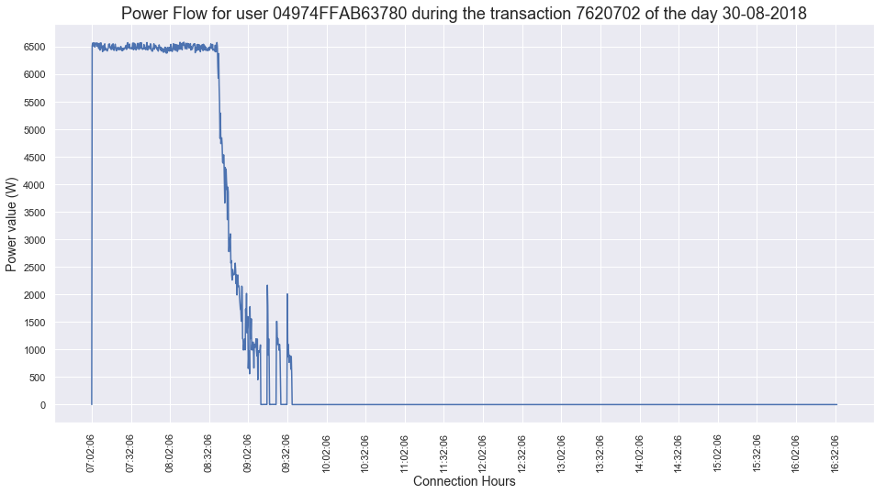
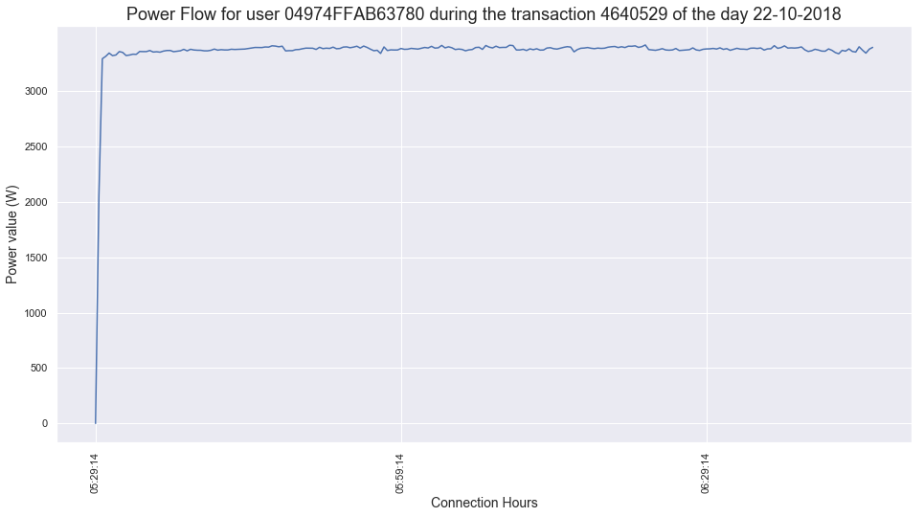
Data Analysis: Charging Transactions Preprocessing
Completed Transaction
Non-completed Transaction
ESAT

Slide 36
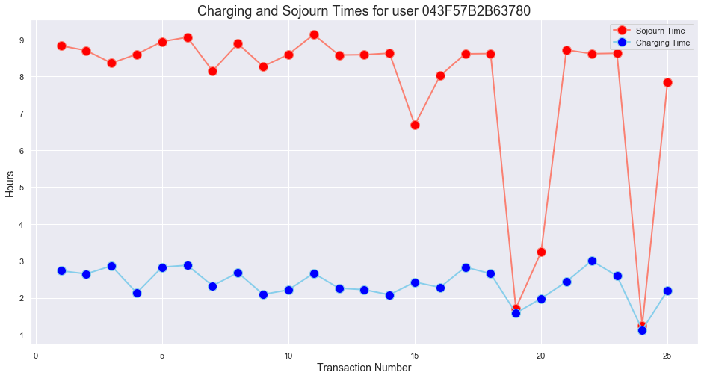
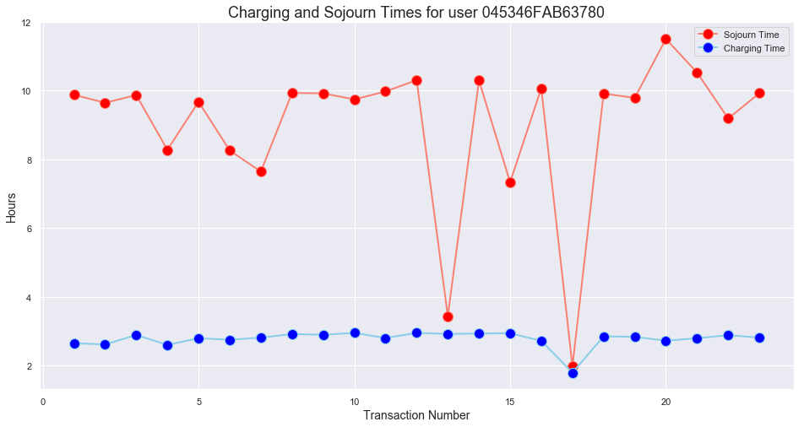
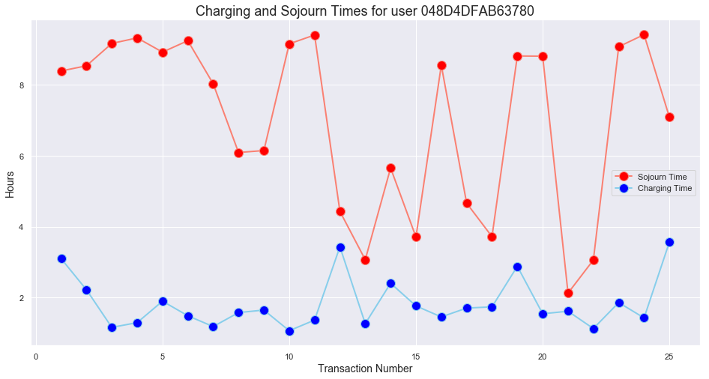
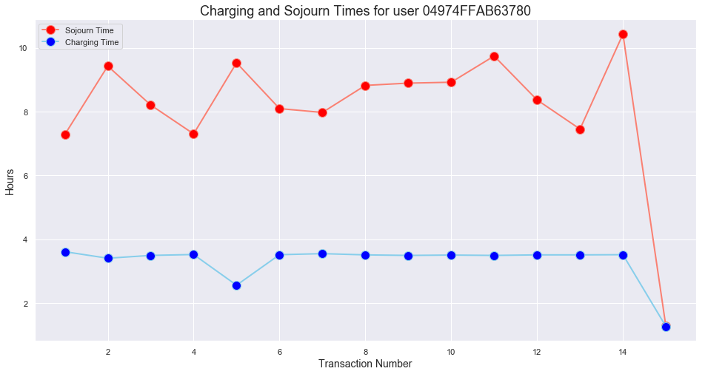
Data Analysis: EV Charging Behaviour
ESAT

Slide 37
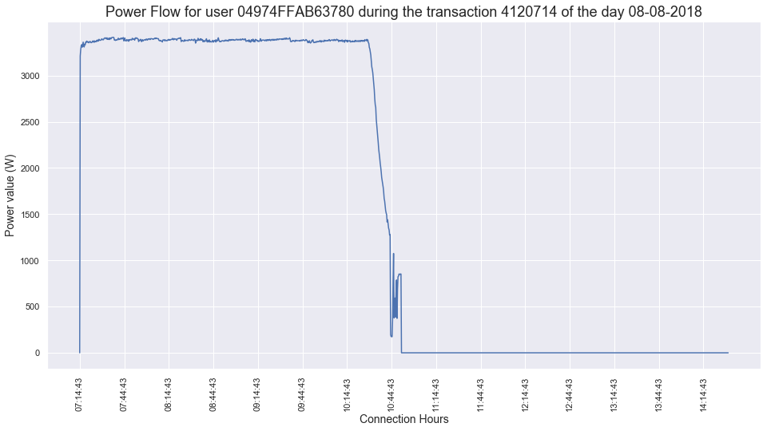
Data Analysis: Conclusions
Is EnergyVille a charge near work cluster? Yes!
Arrival times: Early morning (around 6-9am).
Departure times: Late afternoon.
Sojourn times: Average around 9 hours. Min-Max = [5.00, 18.52].
Charging times: It normally happens throughout the day, car sleepovers are an exception.
Idle times: Average is 5h 30min. Min-Max = [0, 15.54].
Is it possible to predict the state of charge only with information about the charging power? No, alternatives:
Ask the user
Extract it directly from the car
C. Develder, N. Sadeghianpourhamami, M. Strobbe, and N. Refa. Quantifying flexibility in EV charging as DR potential: Analysis of two real-world data sets. In 2016 (SmartGridComm), pages 600–605. IEEE, nov 2016.
ESAT

Slide 38
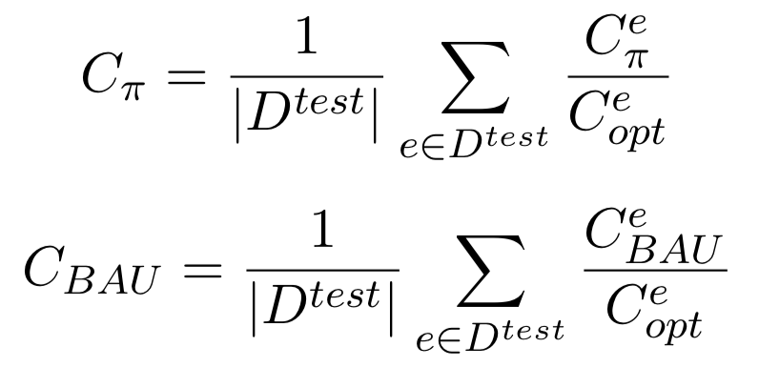
Experiment Setup: Performance Evaluation
Normalized cost relative to the optimum policy
ESAT

Slide 39
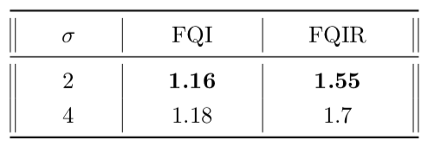
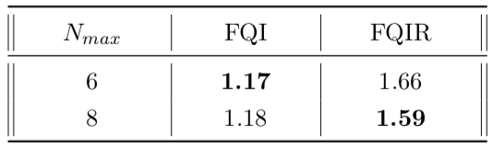
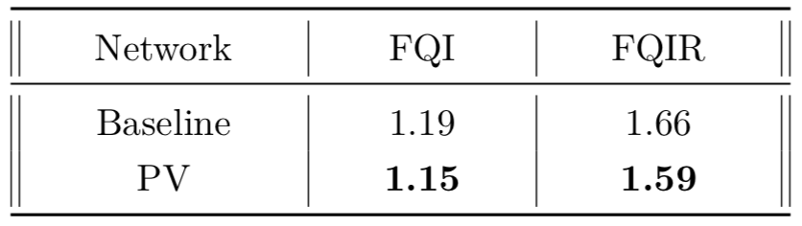
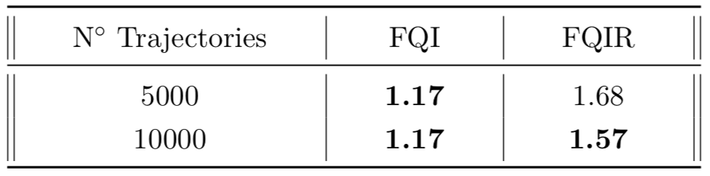
Results: Parameter Selection
Increasing Cost Penalty
Scaling up
Adding Forecast PV Information
Training with more sampling trajectories
ESAT

Slide 40
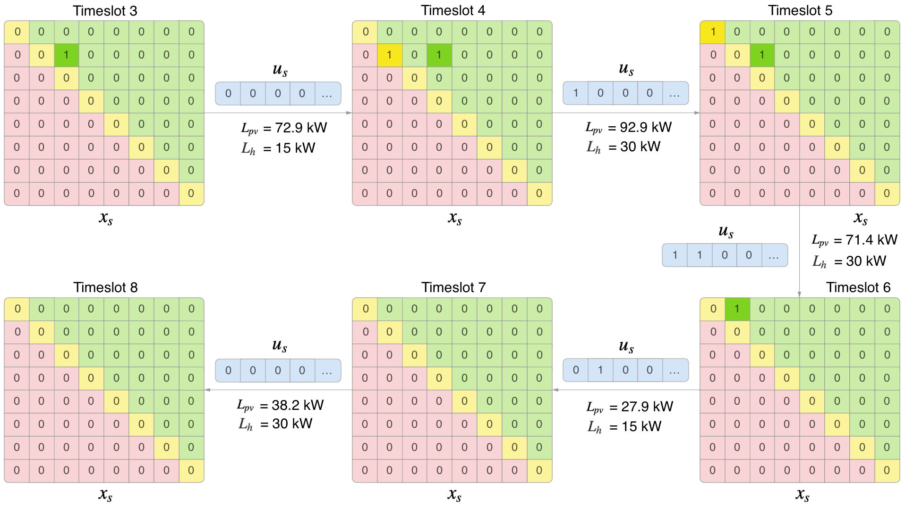
Results: Late Charging FQIR
ESAT

Slide 41
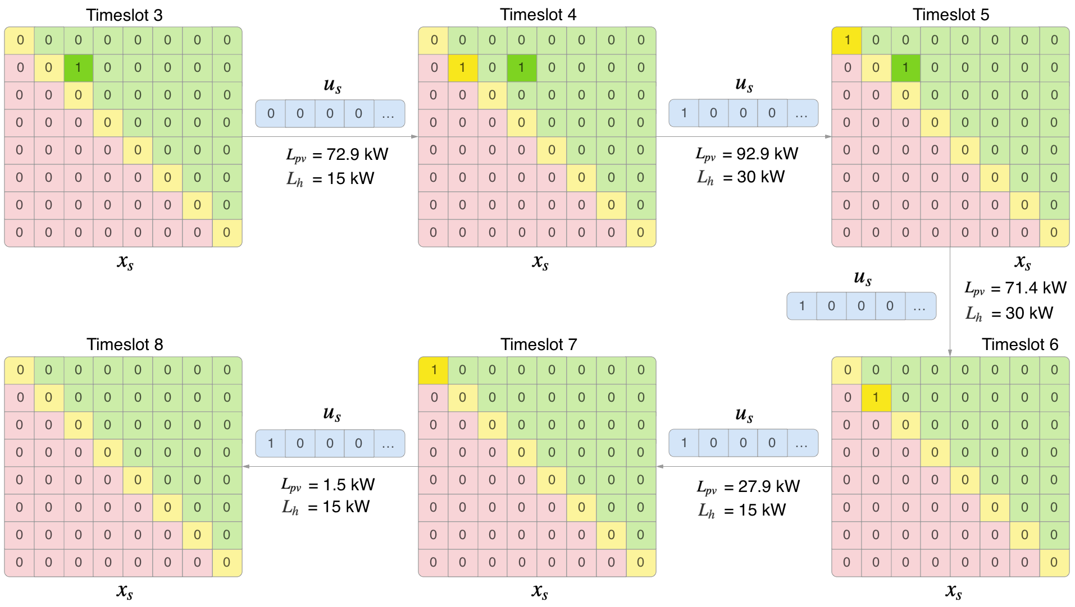
Results: Late Charging FQI
ESAT

Slide 42
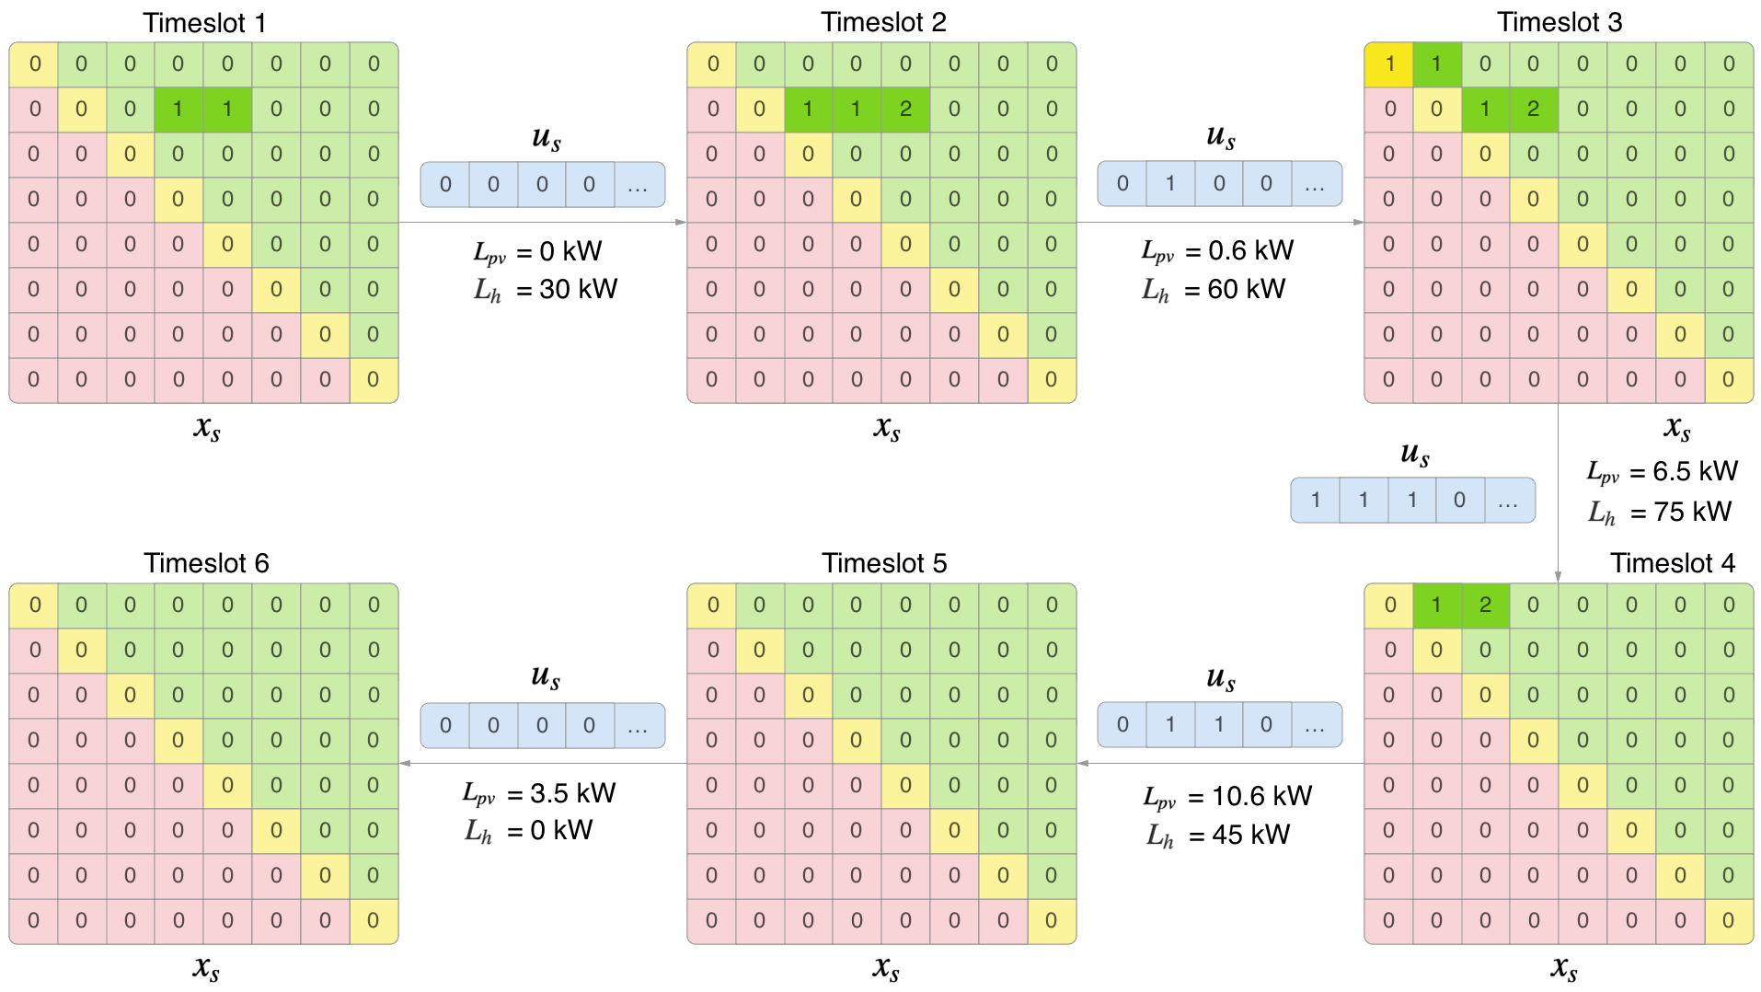
Results: Cloudy Day FQIR
ESAT

Slide 43
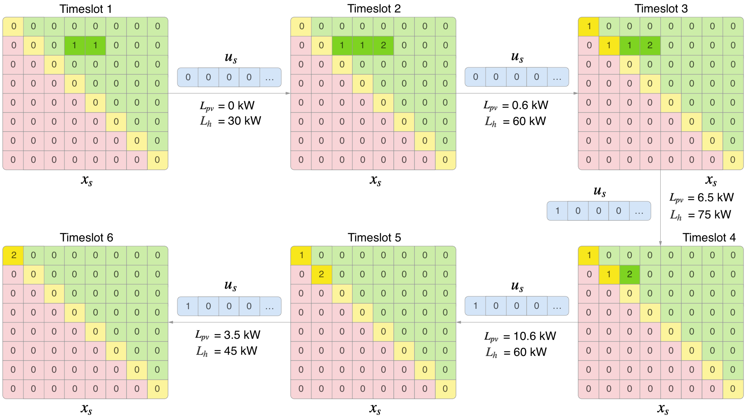
Results: Cloudy Day FQI
ESAT

